Slide 1
Final Project Progress Update 1
Diego Ferrer | Owen Farthing

Slide 2
Recap & Changes
Project:
Analyzing Robinhood user behaviors & stock prices
Finding correlations between them
Predicting good practices based on results
Changes:
Chose better dataset for stock prices
Upgraded Sagemaker instance for larger memory

Slide 3
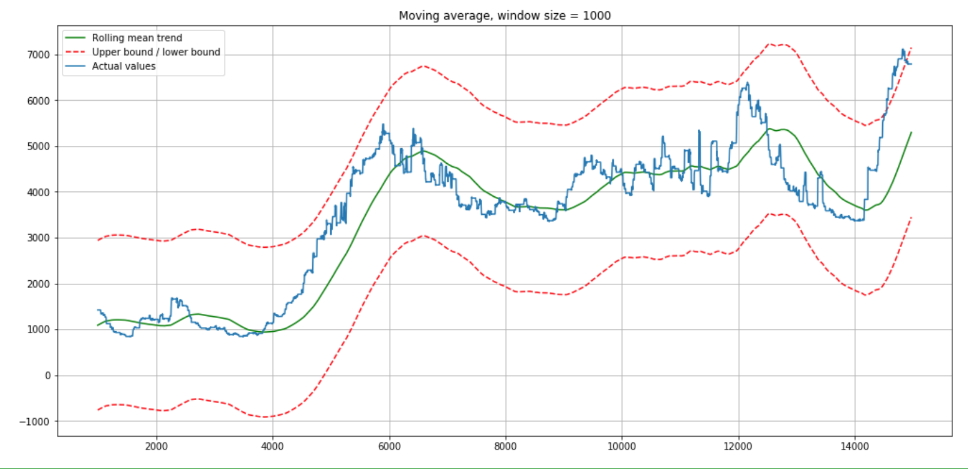
Moving Average for Time Series Data

Slide 4
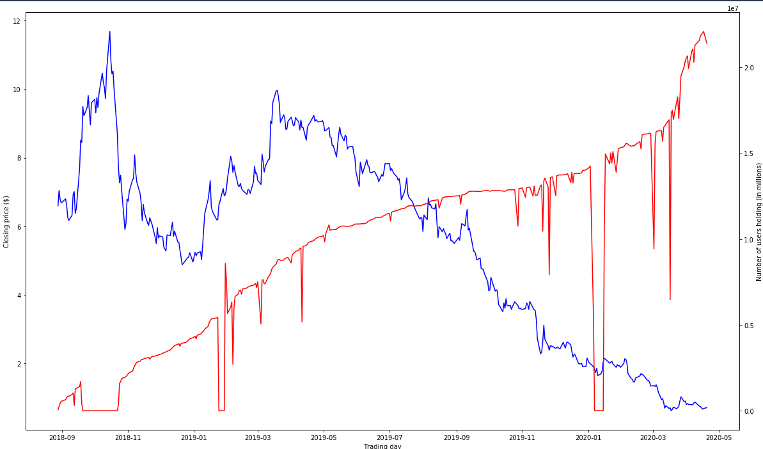
Closing Price (blue) vs. Users Holding (red)

Slide 5
Tools and Methods
Sagemaker Studio Notebook
Pandas
Matplotlib
Numpy
Datetime
MA function
S3

